Slide 1
Threat Detector®
v1.1.0
Team H
Mark Biegel, Tim Yingling, Jenna Pasternak, Scott Boyd,
Clement Onoja, Biruk Yimer
Notes:
Scott

Slide 2

What is it?
Virus hash and URL scanner
Versatile and robust application
Uses VirusTotal API for scanning capabilities
Notes:
Scott

Slide 3


Why Threat Detector is needed
Need to be able to scan file hashes to see if they are malicious
Enables users to see if a file is malicious before using or executing it
Scan websites to see if they contain malicious content
Enables users to see if a site is malicious before visiting it
Notes:
Scott

Slide 4

Motivation
Create a website similar to VirusTotal
Main goal: report and store status of given file hashes
Extra feature: report and store status of URLs
Allow for cohesive user experience between scanning hashes and URLs
Notes:
Scott

Slide 5

Our Tools of Choice
Chose to use tools we made ourselves familiar with during the homework
SQLite3
Flask
Python
Had to make our front end look nicer than plain HTML
Bootstrap
Organization
Github
Jira
Notes:
Scott

Slide 6
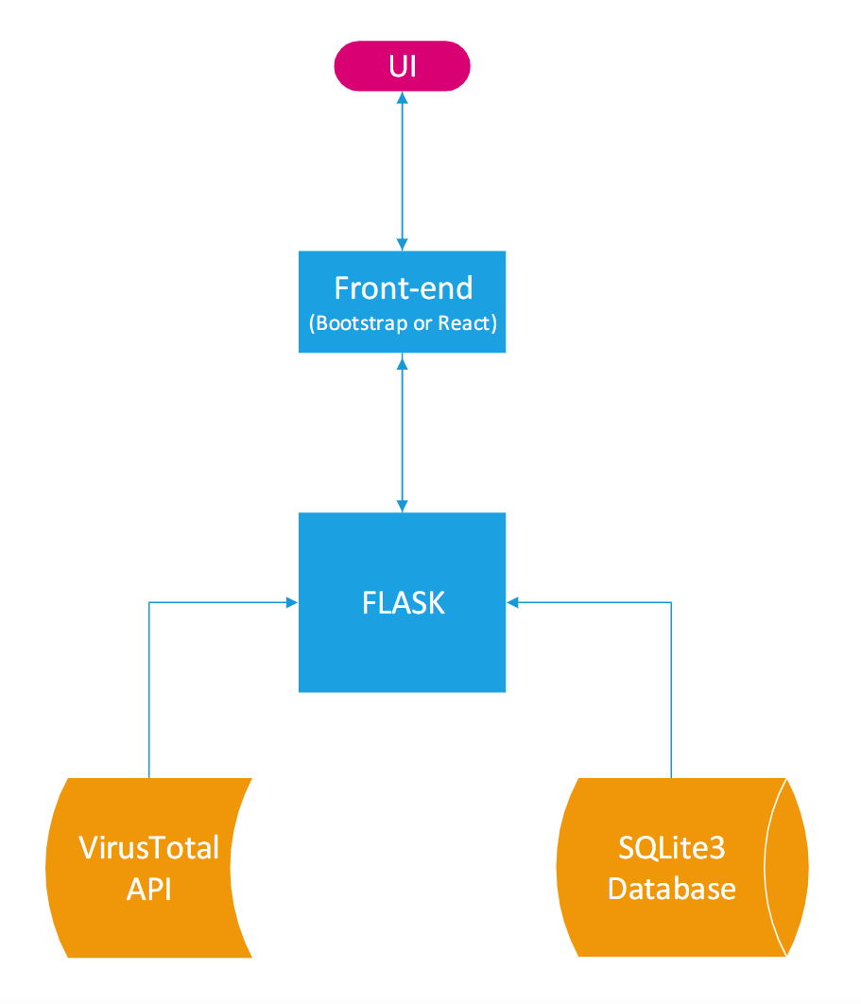
Starting our Design Process in Sprint 1:
Architectural Design
Notes:
Jenna
Based off of our Initial Design, so our extra feature wasn’t in mind at this point
Flask gets info from VirusTotal
Flask gets and sends info to our Database
Flask routes to different pages on our
Front-end
User interface displays

Slide 7
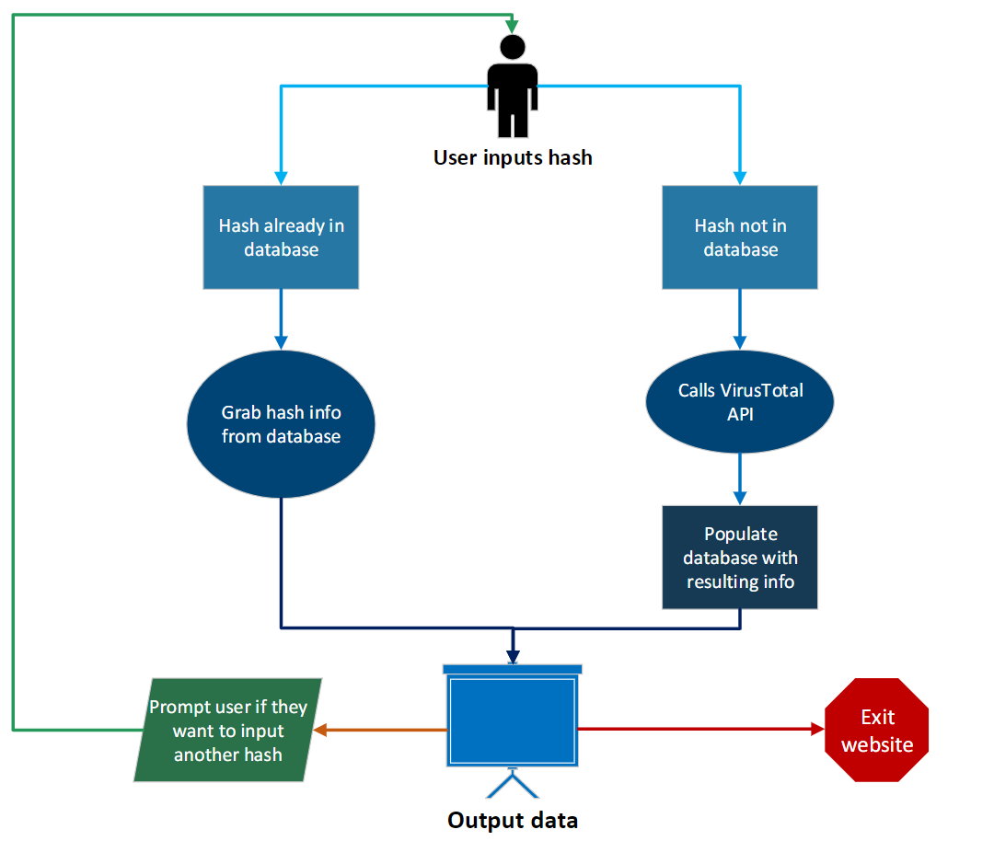
Average Use Case: Activity Diagram
Notes:
Jenna
It helps software developers and businesses design processes from a user’s perspective, and how system interacts with based on actions of user
System checks if hash is in the database of not
If it isn’t

Slide 8

Starting Development: Splitting up the Work for Sprint 2
Split up responsibilities into three categories
Database: Tim Yingling and Jenna Pasternak
Back end: Clement Onoja and Scott Boyd
Front end: Mark Biegel and Biruk Yimer
Roles were not strict
Notes:
Biruk
Roles were not strict as we often helped with tasks outside of our main responsibilities.

Slide 9

Database
Created 3 classes for database functionality
File
Container for file hashes
URL
Container for URLs
Data
Store and Search
Notes:
Tim

Slide 10
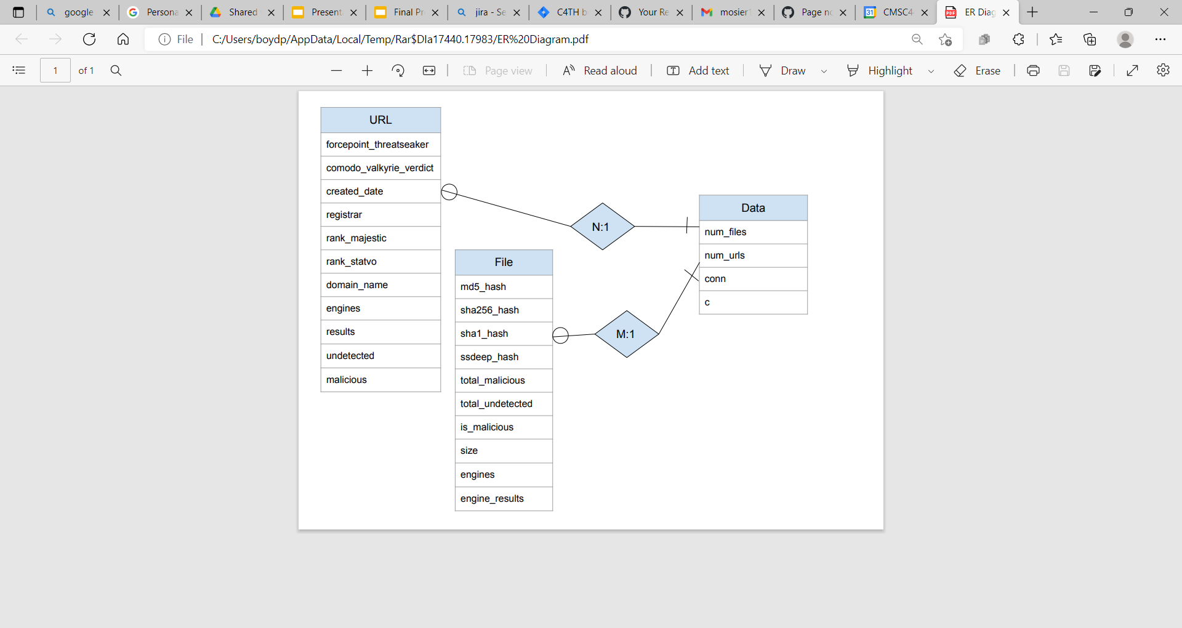
ER Diagram
Notes:
Jenna
Size in bytes
Number of files and URLs touched during the session
c = cursor
the number of vendors flagged as malicious is 25% or more, than the hash is considered malicious

Slide 11
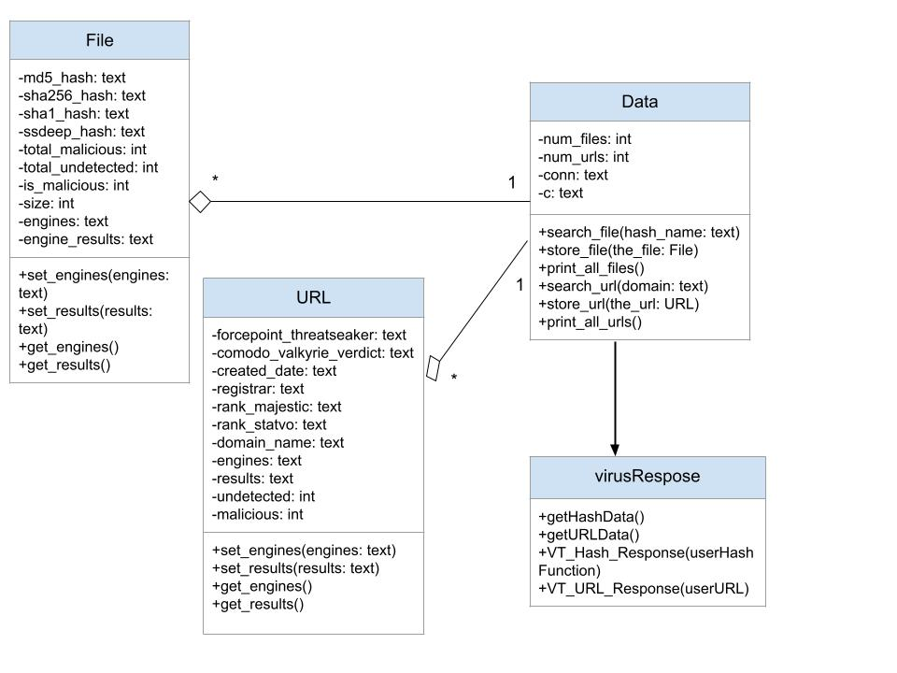
Class Diagram
Notes:
Jenna
White diamond: aggregation association (Data made up of File and URL)
Arrow: Dependency association (Data class depends on Virus Response functions)

Slide 12

Back End: Hashes
Created VirusResponse class to handle working with the API
User can input the hash in the following formats:
MD5
SHA256
SHA1
SSDEEP
VirusTotal retrieves other 3 hash types as well as additional information to store in the database
Notes:
Clement
Uses Flask
Information also includes the number of search engines that determine the file to be malicious or undetected, as well as the engines and results themselves.

Slide 13
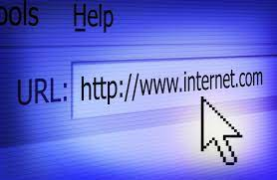
Back End: URLs
Uses a separate API call to retrieve information about URLs
Most of the information is different from file hashes, but engines and results are still retrieved
Challenges:
Differentiate between an entered file hash and URL
Limitations of VirusTotal Free API Key
Required the user’s input to be “cleaned”
Different keywords for malicious vs clean URL
Notes:
Clement
Limitations of VirusTotal Free API Key:
Not all URLs were able to be scanned by our product, and after a little digging, we figured out that the Free API Key doesn’t allow for real-time scanning of URLs. This means that only URLs populated in VirusTotal’s database were valid with the free API key; otherwise, VirusTotal would not return any data. This then required us to “clean” or parse the user’s input and grab only the main domain name from the URL and pass that to VirusTotal instead of passing the entire user URL. For example, “https://www.apple.com/ipad-pro/” is “cleaned” to “apple.com”

Slide 14
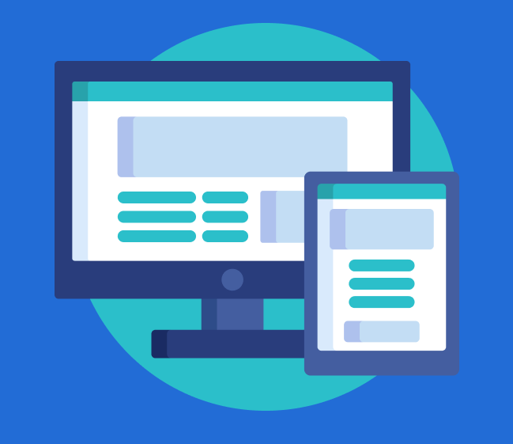
Front-End
User Experience is the forefront of the likability of a product
A cohesive interface is the foundation for a quality user experience.
Threat Detector’s front-end goals:
Cohesive layout from page to page
Scalable on multiple devices
Easy-to-navigate
Simplistic, yet informative
Intuitive actions and responses
Modern and sleek
Notes:
Mark
Talk about overall goals that we want our front end to achieve

Slide 15

Front-End - User Experience Tactics
Rich, Pastel Colors
UI Object shapes and sizes
Graphics-
High resolution images
GIFs
SVGs
Thin, crisp fonts
Output information sized larger or smaller based on importance of information
Notes:
Mark
A variety of different tactics are used to enhance the user experience of Threat Detector.
UI Object shapes and sizes: Squared off with slightly rounded corners
SVGs are Scalable Vector Graphics that are coded into the site. They are useful because they don’t pixelate when the size of the image changes; they “scale” up in resolution to provide a crystal clear experience. The detection page contains multiple SVGs, and the service’s Logo is an SVG as well

Slide 16
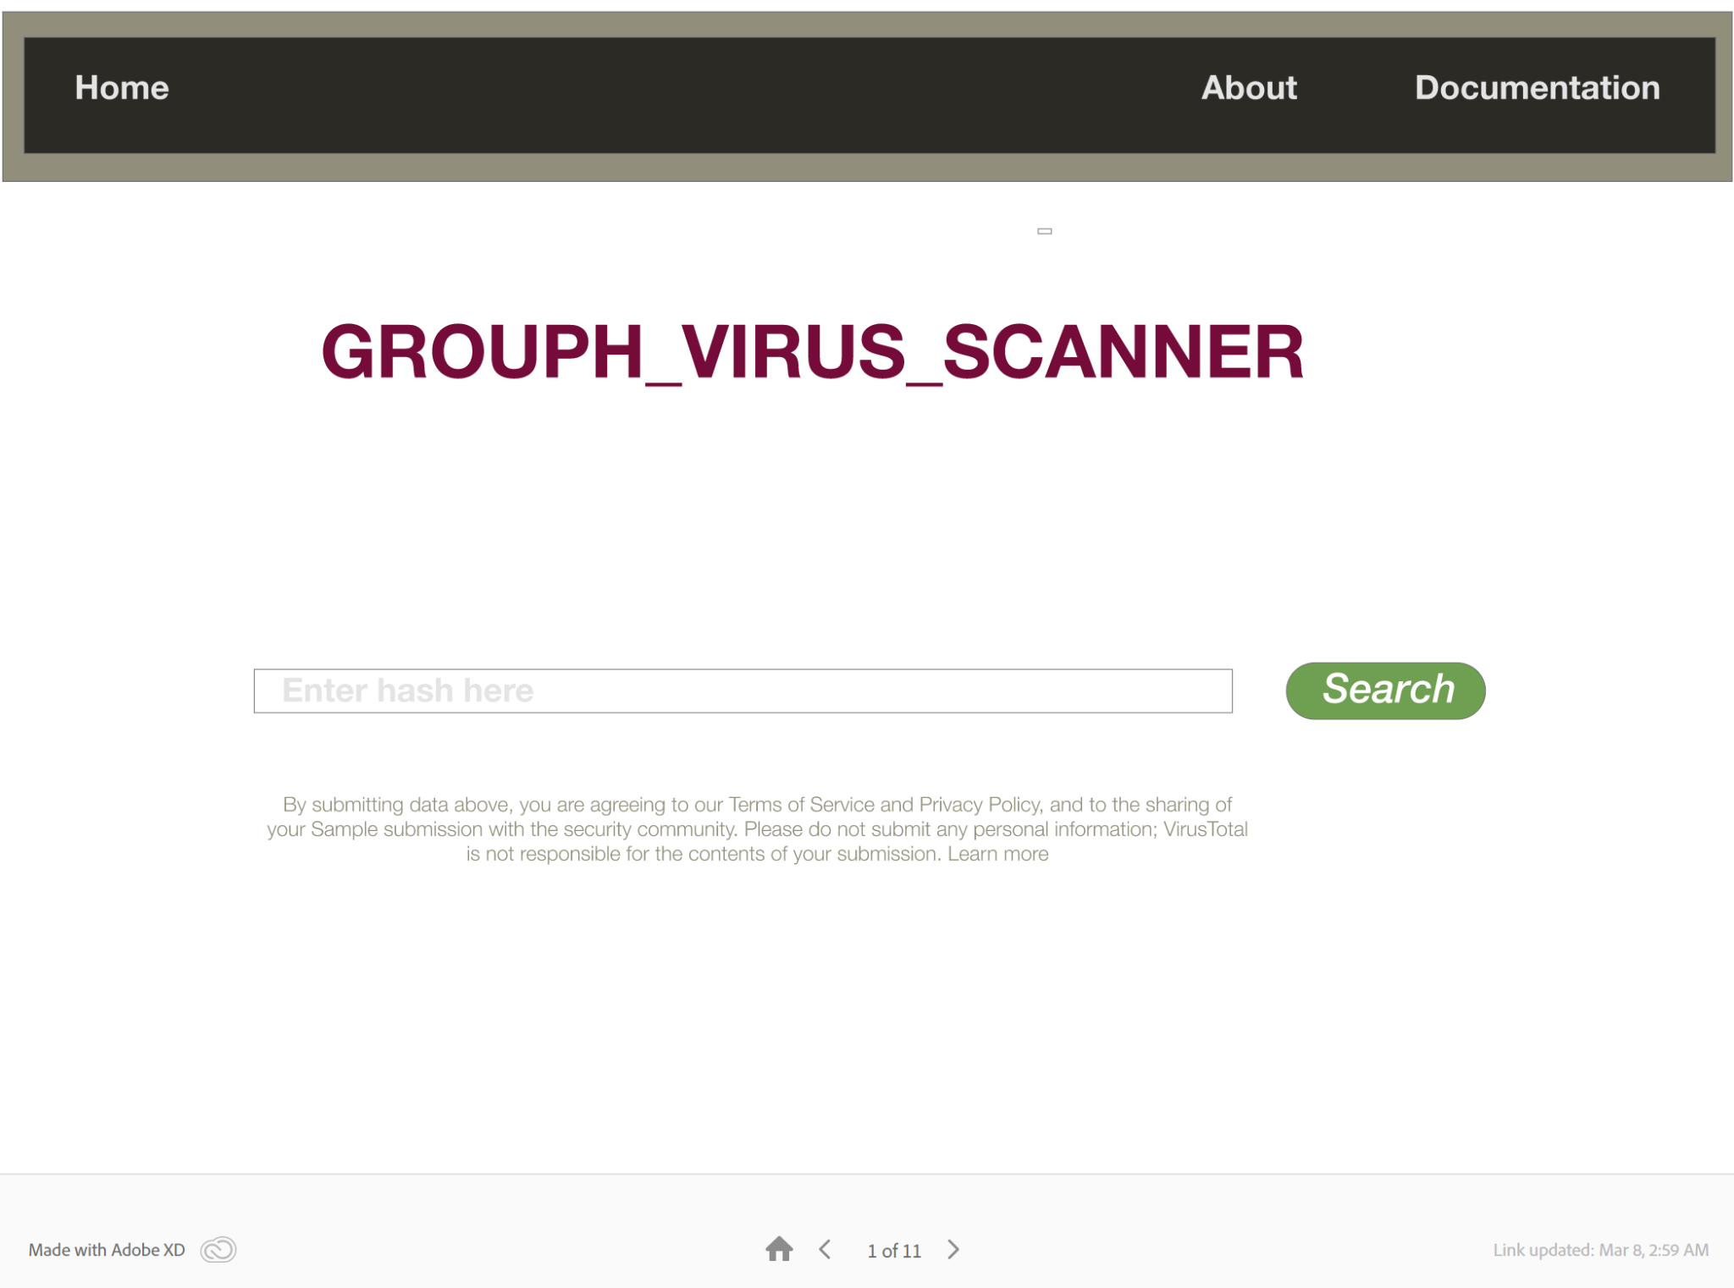
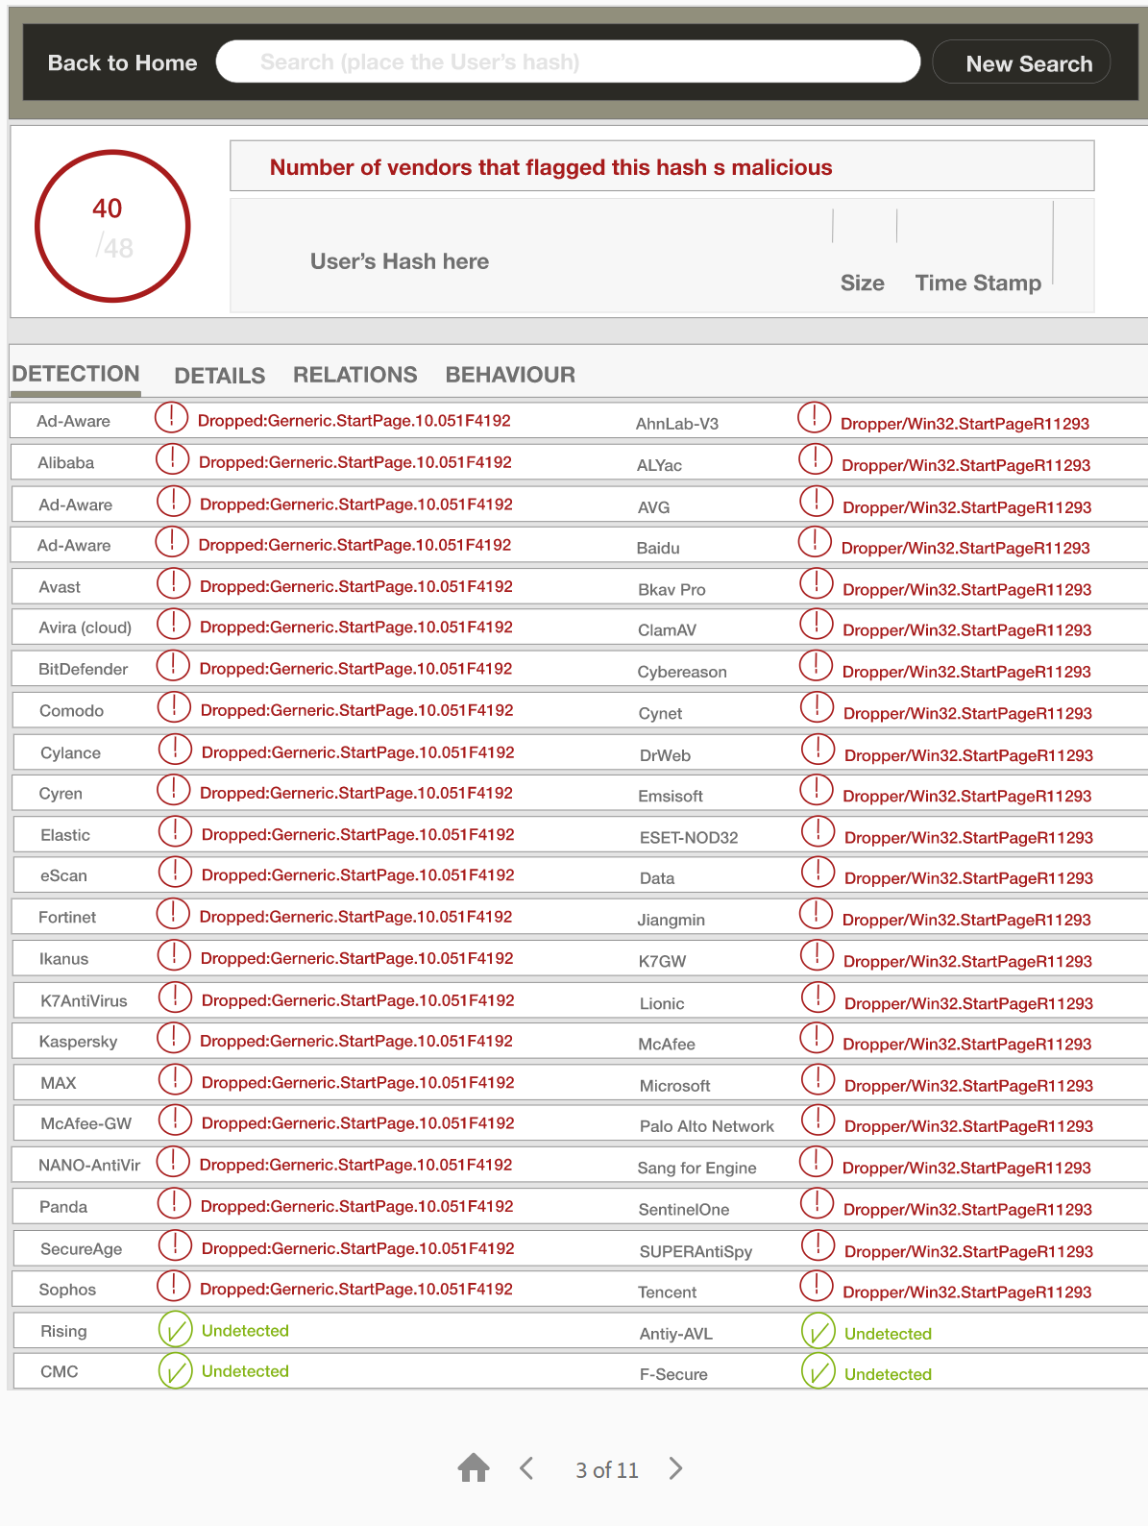
Front-End - Initial Mock-up
Mock up of potential front-end’s look and feel made in Adobe XD
Notes:
Clement
Mockup made in Adobe XD….it looks very similar to the setup and layout of VirusTotal.

Slide 17


Front-End - Layout
Bootstrap Framework with CSS for easy implementation and cohesive appearance
Front-end composed of 8 pages:
Homepage
About
Help
Invalid Entry
Malicious Hash and URL (x2)
Clean Hash and URL (x2)
Notes:
Biruk
With and Adobe XD mockup, we determined that Bootstrap and CSS would serve our purpose for making the mockup come to life
We have 8 pages involving front end. There are 2 pages for malicious and clean entry (one for hash and one for URL). The reason for doing this is because hash and URL contain different types of data, and we thought it would be easiest to make a separate page for malicious and clean URLs apart from malicious and clean hashes. In the end, we realized that it is unnecessary to have separate pages for malicious and clean URLs.

Slide 18

Testing Our Product
Tested code as it was developed, but wrote formal tests once the product was complete
White box testing
Most of the database functionality
Black box testing
Testing the product as a whole
Notes:
Tim

Slide 19
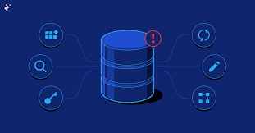
Database White Box Testing
Created a single test file: data_test.py
Started tests on an empty database file
Made sure that search and store functions worked correctly
All database tests passed without having to modify the code
Notes:
Tim

Slide 20

Front-end Black Box Testing
Testing was performed by using different inputs
Main focuses:
Displaying the correct status for hashes and URLs
Invalid inputs
Routing works correctly
Notes:
Mark

Slide 21

Important Documentation
All documents are available in the Github repository
README for our source code
Administrator Manual
System Testing Documentation
Notes:
Biruk

Slide 22
Demo Time!

Slide 23
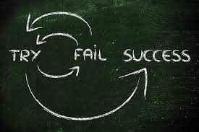
Lessons Learned
Learned how to use GitHub
Maybe not the best use of it, but learned how to separate development and merge code
Also learned how to use organization software with Jira
Being thrown into web development was a good way to learn
Not fun in the moment, but overall beneficial
Learned that we shouldn’t be calling the API 10 times per run
Our first major “bug”
Notes:
Tim

Slide 24

If We Were to do it Again…
Plan out the extra feature earlier
Have more meetings to explain developmental decisions
Communication was a weak point
Have a better foundation for the project in our sprint 1
Didn’t translate as well in our sprint 2
Consolidate front-end HTML pages
Notes:
Mark

Slide 25
Computer Science 447 Overview
Benefits:
Homework 1 was VERY helpful (being thrown into it was helpful)
Gained experience working with a team
Areas for Improvement:
Better communication from professor to teams for what is expected of them
More discrete instructions
Alternative software to Jira (i.e Github Projects)
Notes:
Scott

Slide 26
Questions?

